Slide 1
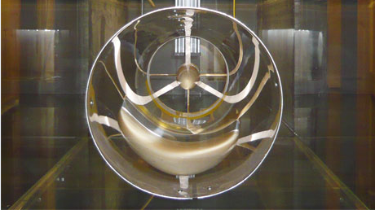
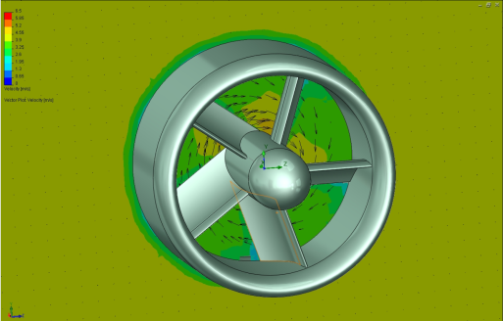
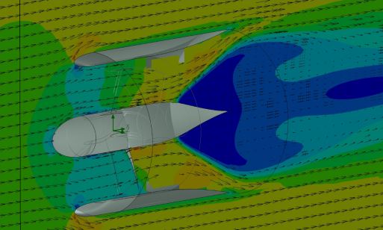
Green-Tide Turbines
VAR: NT CADCAM
Cambridge, UK
Company:
Green-Tide Turbines Ltd pursues R&D activities in the UK, addressing two different markets; run-of-river and tidal-stream. They develop turbines which use natural water movement to generate electrical energy from river currents and tide streams, and aim to develop technology that will ‘do for water turbines, that the jet engine did for aviation’.
Challenge:
To create a revolutionary turbine to generate electricity from slower tidal currents that leave conventional turbines useless. The turbines must balance ruggedness with cost. Tidal turbines are expensive to install and take a constant pounding from currents and salt water. They have to resist corrosion, cavitation and mechanical failures because the time for repairing them can be as short as 30 minutes, four times a day.
The turbines have to be durable, because it can be several weeks before anyone can get to one and fix them. By then they could’ve destroyed themselves and other turbines. Even when you can get to the turbine, hauling it out of the water to repair it and manoeuvre it into a ship is complicated and expensive. The key challenge was to reduce mass without sacrificing durability.
Key Benefits:
Founder Michael Evans, uses SolidWorks CAD and Flow Simulation to visualise ideas for the turbines which use duct with a stator/rotor arrangement to convert the action of water flowing through the duct to generate electricity. Most tidal turbines, by comparison, use bladed fans or oscillating hydrofoils that move with the tides. Green-Tide’s design can generate electricity cost effectively , in weaker currents. When he has ideas for modifying the design, he works them out using CAD and Flow Simulation, before showing them to his engineering team for possible development.
Evans modifies his designs with SolidWorks CAD and simulates their behaviour with SolidWorks Flow Simulation to improve the turbines’ survivability. That ultimately, improves their economic viability, which is a constant challenge in the renewable energy industry. Once he and his engineers have finalised a modification, they send a SolidWorks 3D model to a rapid prototyping partner that produces a part for live testing.
‘I’m not the sort of person who has the patience to sit and work things out…having easily accessible tools that help me express an idea helps me greatly. I have something to show my engineers to show there’s some substance to the idea. SolidWorks is like a very advanced sketchbook. It gets me 80 percent of the way to a finished design with 20 percent of the effort’
Michael Evans, Founder, Green-Tide Turbines

